Slide 1
Summer Project Initial Plots
Adam Shah

Slide 2
Correlations between eyes and between large and small VEP

Slide 3
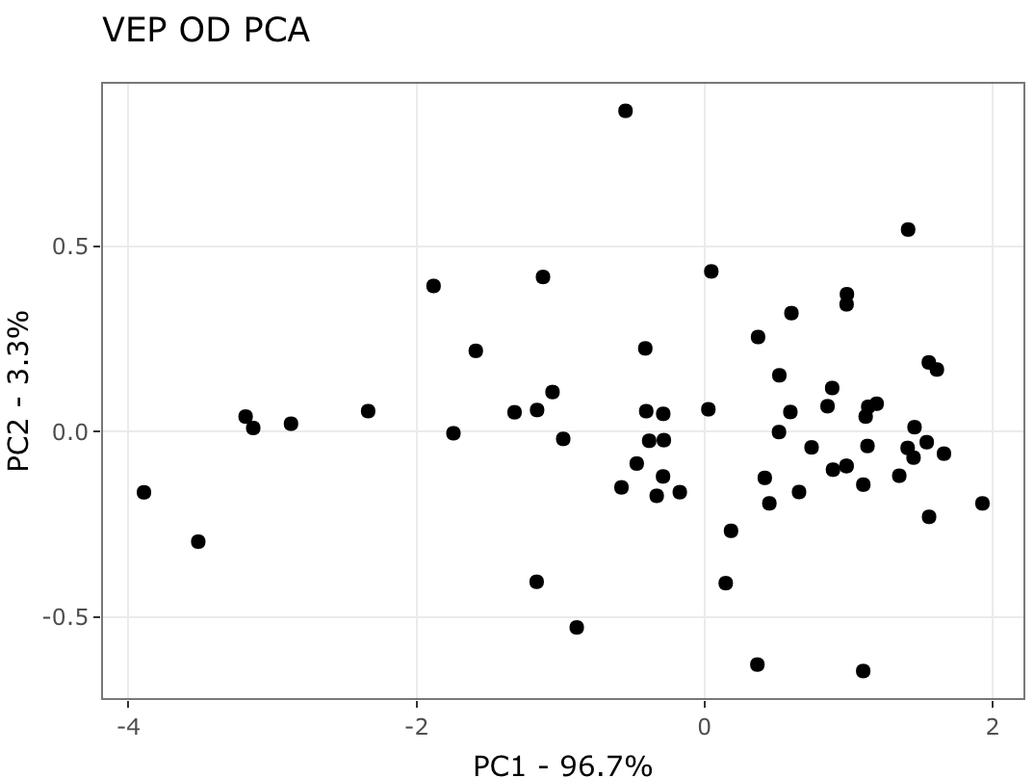
PC plots combining large and small VEP

Slide 4
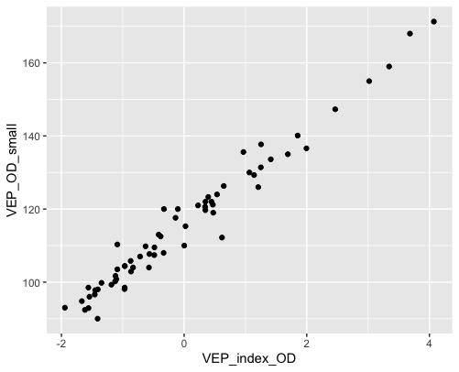
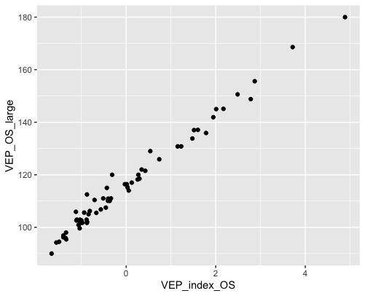
Check for validity of PC variable

Slide 5
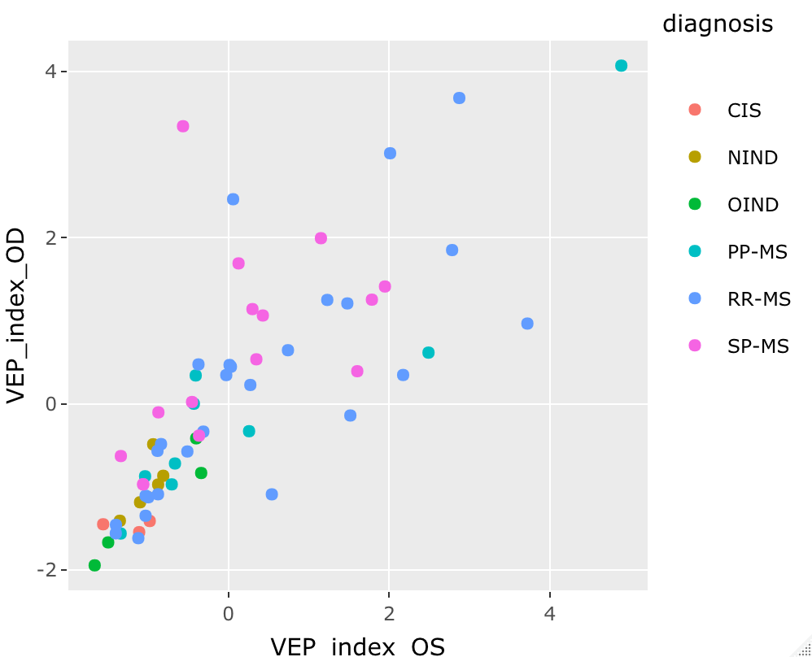
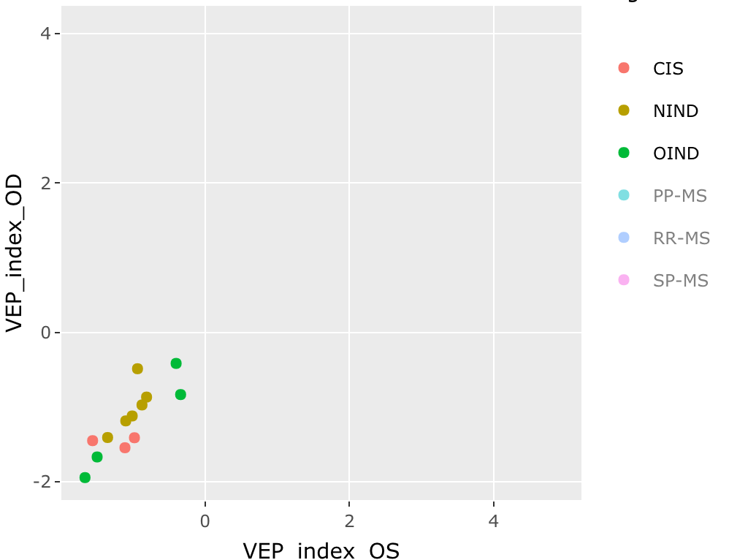
Comparing left and right eyes using new VEP index
file:///Users/adamshah/Desktop/Adam%20Shah/RSandbox/index.html (interactive version)

Slide 6
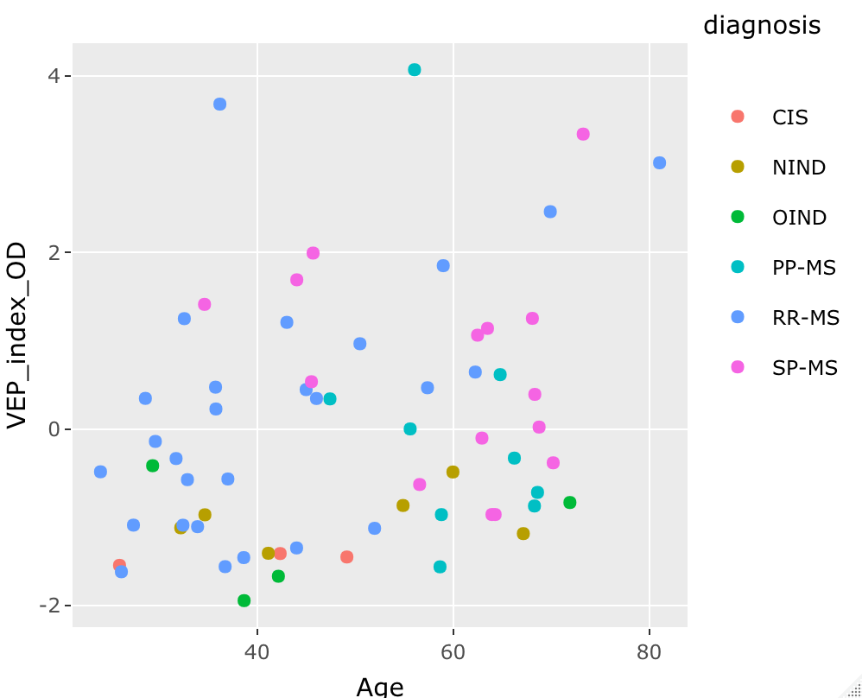
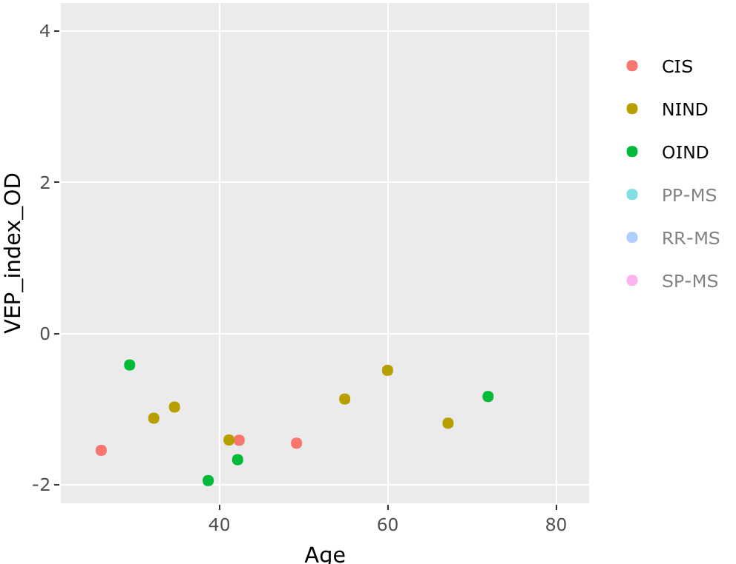
VEP index vs. Age

Slide 7
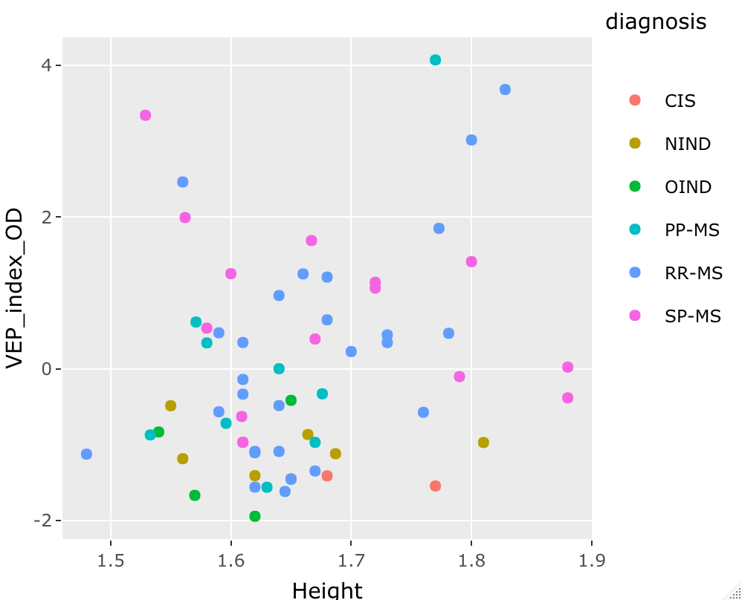
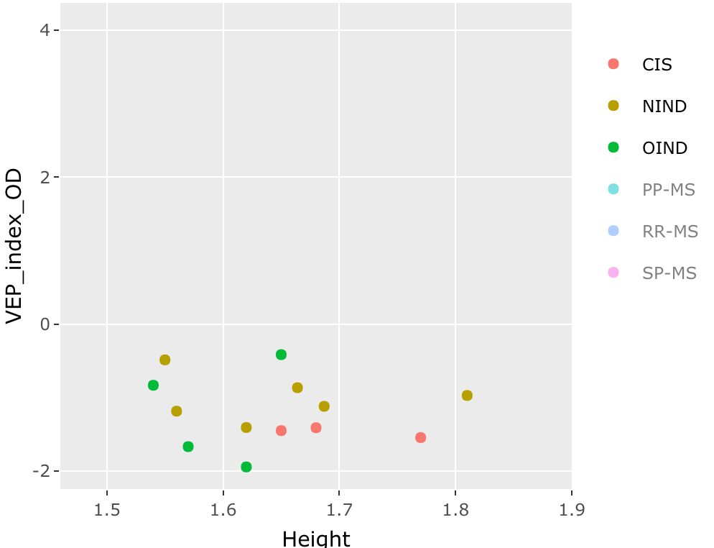
VEP index vs. Height

Slide 8
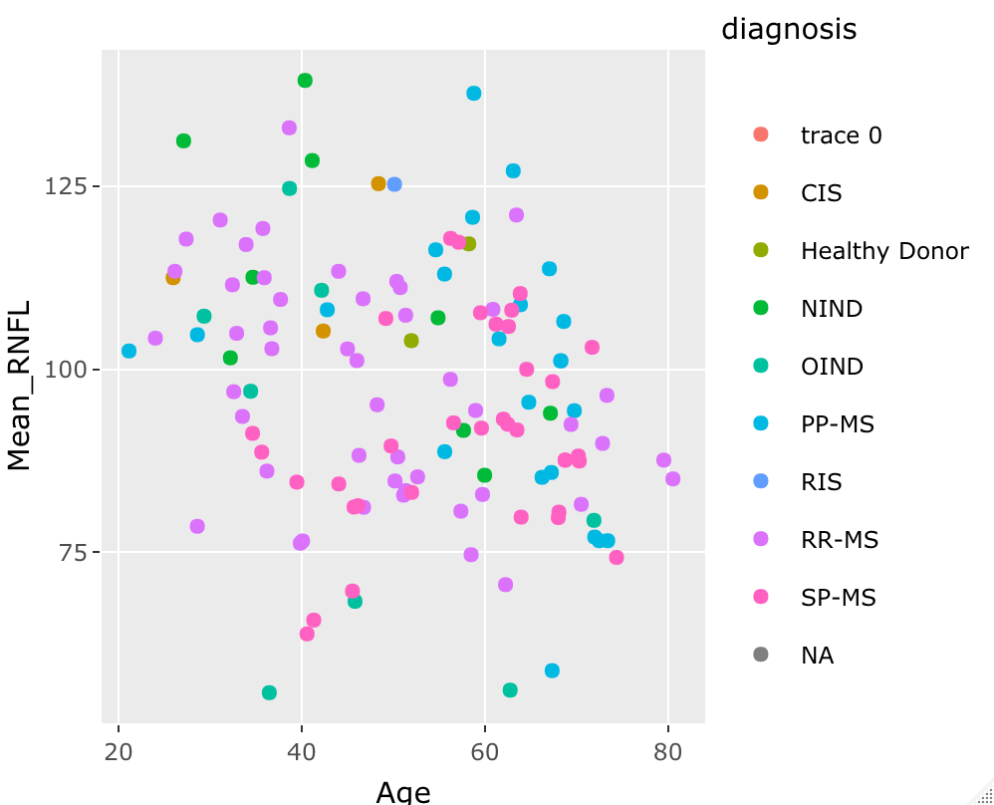
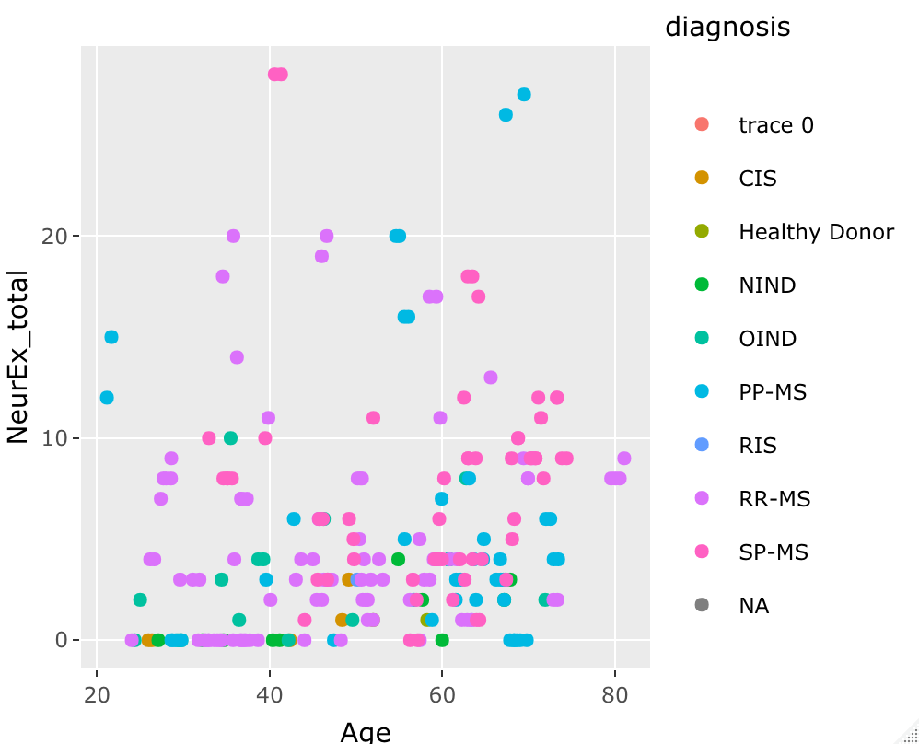
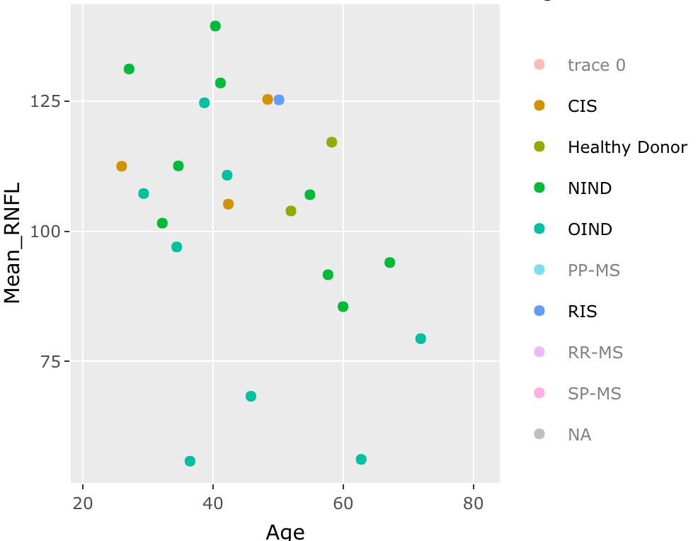
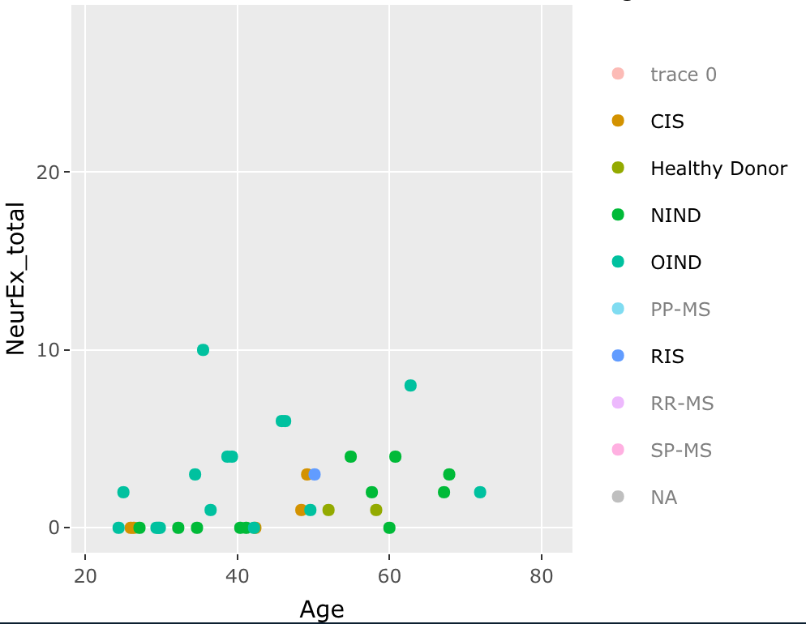
Effect of Age on RNFL thickness and total NeurEx score (both show slightly better relationships when excluding MS patients)

